Slide 1
Linear Programming:Introduction
CSB18038
CSB18042

Slide 2
What is linear program?
Optimization problem consisting in
Maximizing(or minimizing) a linear objective function
Of n decision variables
Subject to a set of constraints expressed by linear equations or inequalities

Slide 3
Why linear programming is a very important topic?
A lot of problems can be formulated as linear programs.
There exist efficient methods to solve them.
Or at least give good approximation
Solve difficult problems like Assignment problem, Transportation problem etc.

Slide 4
Terminology
X₁ , X₂ : Decision Variables
max(1000X₁ + 900X₂): Objective
Function
Subject to : Constraints
3X₁ + 3X₂ <= 21
3X₁ + 4X₂ <= 28
X₁ >=0 , X₂ >=0

Slide 5
Different Methods to solve LP Problems
Graphical Methods
Algebraic Method
Algebraic Method using Simplex Algorithm.

Slide 6
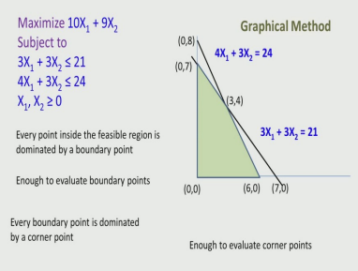
A. Graphical Method
In graphical method we draw the lines on the graph by using contraints inequality and then find the feasible region in the graph. We then evaluate the objective function at corner points of the feasible region and get the optimum solution.
For eg : We will evaluate the objective function : 10X₁ + 9X₂ at different corner points.
A(X₁=0 , X₂=7) : 63
B(X₁=0 , X₂=0) : 0
C(X₁=6 , X₂=0) : 60
D(X₁ =3, X₂=4) : 66
Since at point D(X₁ =3, X₂=4) we have maximum value hence it is optimum solution.

Slide 7
Limitation of graphical method
This method can be used only when there are two decision variables. If we have more than two decision variables this method will not work.

Slide 8
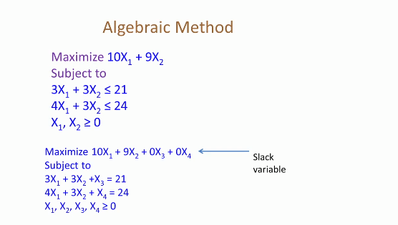
A. Algebraic Method
Now In order to solve the LP problems using algebraic method we will first convert the constraint inequalities to equation by using some extra variable known as slack variable.
For eg : In order to convert 3X₁+3X₂≤ 21 we add a slack variable X₃ to left side since we have <= condition.
Now since we have here only two equations but four variables so we can solve for two variables only so we need to fix some value to remaining variables preferably 0. The variables for which we will solve the equation is called basic variable and the variable whose values are fixed are called fixed variable.

Slide 9
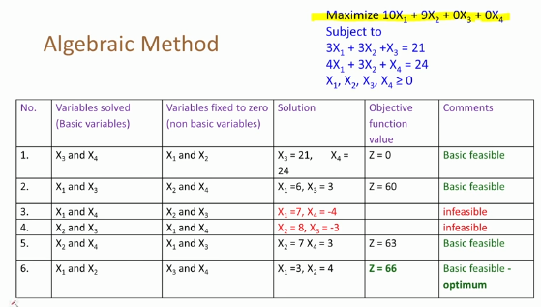
A. Algebraic Method
Since we have 4 variables we will choose two variable among these at a time so we will have total ⁴C₂ basic variables.
Now we will make table of basic variables and fixed variables and assuming value of fixed variable to zero we will find the value of basic variables and if the values of basic variables satisfy above constraints we will evaluate the objective function otherwise we will comment it to be infeasible as we have shown in the diagram.
The basic variable with highest value is the optimum solution.

Slide 10
Summary of Graphical and Algebraic method
Graphical Method is use for two variables
Algebraic method evaluates large number of solutions – including infeasible solutions.
Do we have a method that
Evaluates only feasible solutions.
Evaluates better solutions as it progress.
Stops when best solution is reached(before evaluating all feasible solutions).

Slide 11
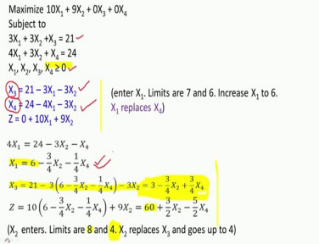
Simplex Algorithm
We first start by considering the slack variables as basic variables and the remaining variables as fixed variable whose value is 0.
Now as we can see that since X₁ and X₂ is zero the objective function Z will be 0. Now we can increase the value of z by increasing either X₁ or X₂ , but since the coeficient of X₁ is larger than coefficient of X₂ therefore we will increase the value of X₁ now the value of X₁ can be either 7 or 6 we will choose minimum of them therefore new value of X₁ will be 6 and X₄ will be zero so X₂ and X₄ will be new fixed variable we will right the constraints by considering X₁ and X₃ as basic variable and also rewrite z in terms of fixed variable.

Slide 12
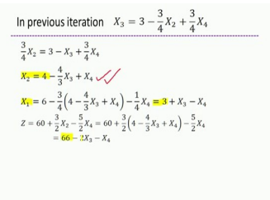
Simplex Algorithm
We will repeat the same process until we cannot further increase the value of z or reach to the optimum solution.
So in this algorithm we can see that we have not evaluated any infeasible solution also we have taken lesser number of steps to reach the final optimum solution because in each step we are finding the next highest value of z by finding the value of variable with higher rate of increase.

Slide 13
Transportation problem
In transportation problem there are different supply points and different demand points we have to meet the demand using minimum cost.
In order to solve above problems we can use different methods as we have seen to solve LP problems but it often become much complicated so to solve transportation problem we use different methods in which first of all we represent the problem matrix form in which rows represent supply and columns represent demand.

Slide 14
Different methods to solve Transportation problems
North west corner rule
In north west corner rule we start with the north west corner of the matrix and allocate it as much as we can.
It will give the starting solution but we cannot claim that it will be optimum.

Slide 15
Different methods to solve Transportation problems
Minimum Cost method
In this method we find the cell in the matrix with minimum cost and allocate it as much as we can.
It will also give the starting solution but we cannot claim that it will be optimum

Slide 16
Different methods to solve Transportation problems
Penalty cost method
In this method we first find out the penalty associated in row and column. We will pick the row or column with maximum penalty and tried to fill the least cost position in the corresponding row or column so that we can avoid the penalty.

Slide 17
Now in order to verify that whether the solution given by above methods is optimal or not and to get the optimal solution in case the solution is not optimal we have different methods like:
Stepping Stone Method
Modified Distribution Method

